Slide 1
Half-Precision FMAC

Slide 2
Feature
A 3-stage Half-precision fused-multiply-accumulate(FMAC)
Optimized for low area
Targeting 1 GHz at TSMC 28nm HPC+ 9T 30P140 -40C (tcbn28hpcplusbwp30p140ssg0p81vm40c)
Only support vector single width add/sub/mul/fma instructions

Slide 3
Abbreviation
NaN: not a number
Inf: infinity
fracA/fracB/fracC: significant of operand 1/2/3
expA/expB/expC: exponent of operand 1/2/3

Slide 4
Interface - Input
input | Bit width | Description
core_clk | 1 | clock signal
core_reset_n | 1 | reset signal, active low
f1_valid | 1 | valid input
f1_round_mode | 3 | rounding mode 0: Round to Nearest, ties to Even (RNE) 1: Round towards Zero (RTZ) 2: Round Down (RDN) 3: Round Up (RUP) 4: Round to Nearest, tie to Max Magnitude (RMM)
f1_ex_ctrl | 5 | operations
f1_op1/2/3 | 16 | operands 1/2/3: op1 * op2 + op3

Slide 5
Interface - Output
output | Bit width | Description
f3_wdata_en | 1 | valid output
f3_wdata | 16 | output data of operation
f3_flag_set | 5 | exceptions {invalid, divide-by-zero, underflow, overflow, inexact}

Slide 6
Ex ctrl encoding
Operator | ex_ctrl Encoding
VFADD | 5'b00000
VFWADD | 5'b11110
VFSUB | 5'b00001
VFSUBVF | 5'b00110
VFWSUB | 5'b11111
VFMUL | 5'b00010
VFMACC | 5'b11000
VFMSAC | 5'b11001
VFNMACC | 5'b11010
VFNMSAC | 5'b11011
VFMADD | 5'b10000
VFNMADD | 5'b10001
VFMSUB | 5'b10010
VFNMSUB | 5'b10011
VFPMADT | 5'b11100
VFPMADB | 5'b11101

Slide 7
Fused-MAC
Fused multiply-add performs floating-point multiply-add in one step, with a single rounding
The multiplier multiplies op1 with op2, called the Product, then
Add with the op3, called the Accumulator
In this spec, the op1/2/3 is mapped to opA/B/C
Typically, a fused-mac consists following components
Multiplier: calculate the product of two operands
Aligner: align the accumulator and the product
alignment sticky: it’s impractical to record all bits during alignment, bits shifted-out of effective significant digits are merged into one alignment sticky bit
Adder: sum the accumulator and the product
Normalizer: normalize the added sum
Leading-zero anticipator: to get the normalization shift amount ahead of the addition by analyze the addend bit patterns
Rounding Unit
Generate rounding digits for bounding the result to IEEE 754 format

Slide 8
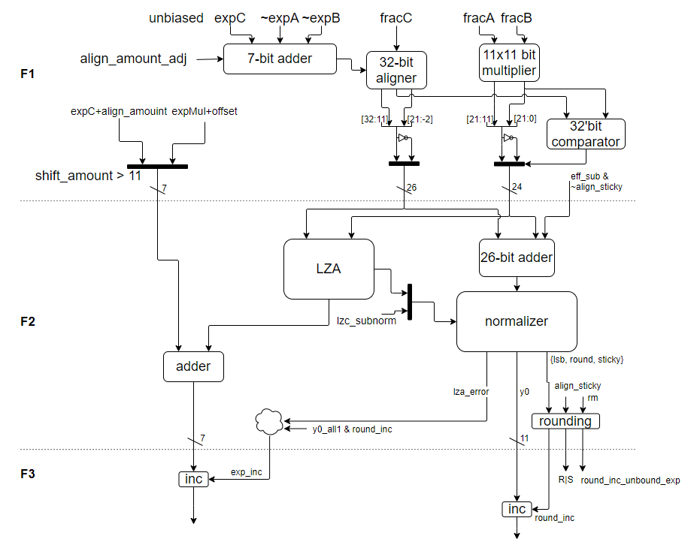
Micro-Architecture – V1

Slide 9
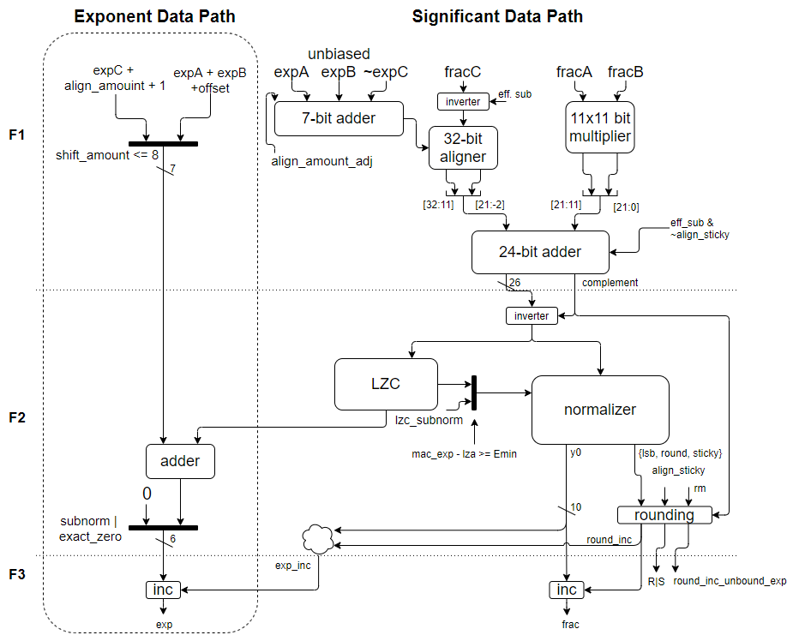
Micro-Architecture – V2

Slide 10
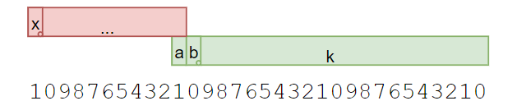

Alignment (1/)
Align amount
For simplicity, the accumulator only do right shift
the accumulator is placed at the left of the product, with 11 digits of offset
align amount = expA + expB - expC + (-bias + offset)
use 4:2 CSA to pre-compress the four operands into two operands, optimize ahead of the compiler
bit width: 5 + 2, since the align amount is ranged from -35 ~ 58

Slide 11
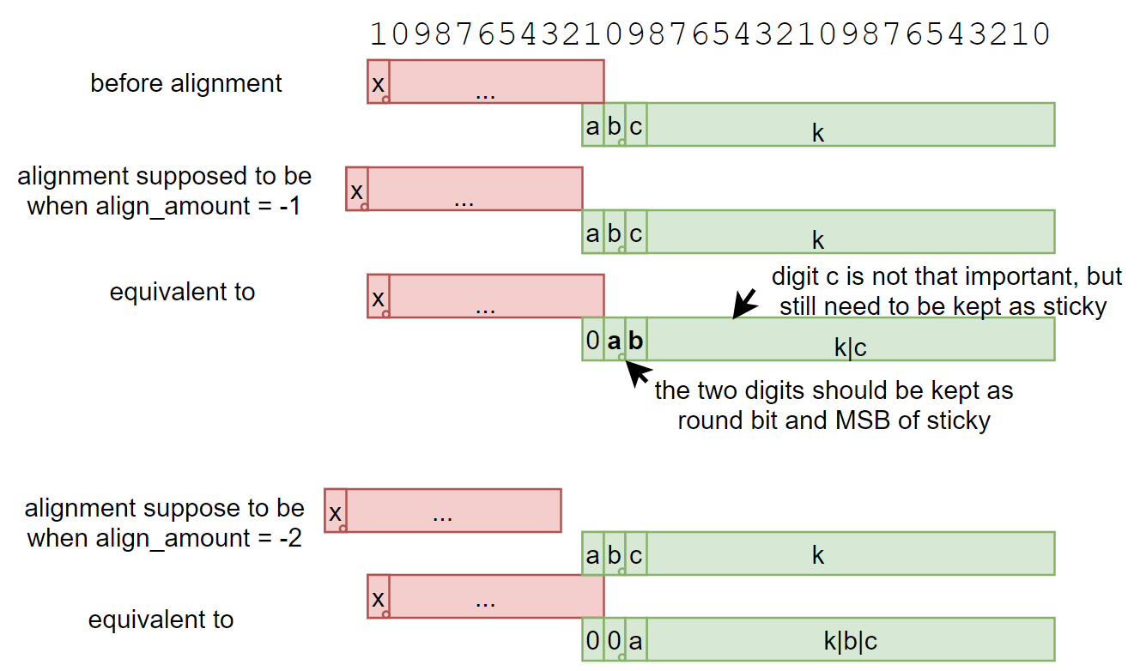
Alignment (2/)
In order to do the alignment with a 5-level barrel shifter

Slide 12
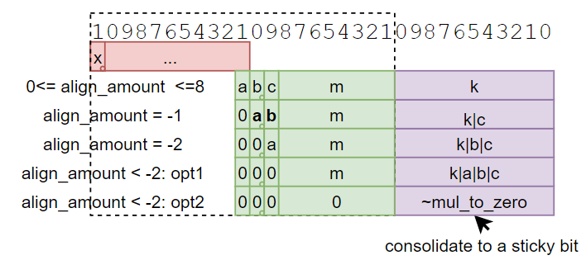
Alignment (3/)
Summarize align_amount <=8 cases

Slide 13
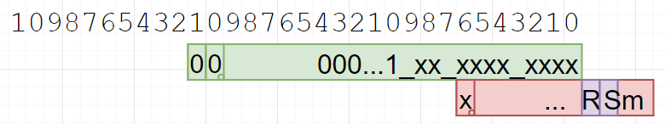
Alignment (4/)
A corner case occurs when the one of opA/B is a vary small subnormal, and the opC is smaller than the product
=> the leading one of the product is at bit 10
=> the bits of opC shifted beyond bit 0 will be the rounding bit and sticky MSB after the summation, they should be kept as effective bits instead of consolidated with other bits to a single sticky bit.

Slide 14
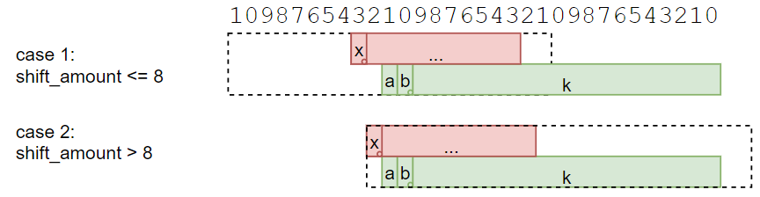
Alignment (5/)
To reduce the pipe register and adder width, the accumulator and the product can be cut from 32-bit to 23-bit, cut-off bits are consolidated into a sticky bit
note that (shift_amount = 9) must not taken as case 1, since the sum might be 0.00…01, the whole K should preserved as effective digits after normalization

Slide 15
Alignment (6/)
Alignment sticky for rounding
case 1: use cut-off product bits
case 2: use accumulator bit shifted beyond 32
Alignment sticky for MAC sum
the eff. sub and no sticky is purely for complete the 2’s complement form
only the accumulator sticky involved in the logic

Slide 16
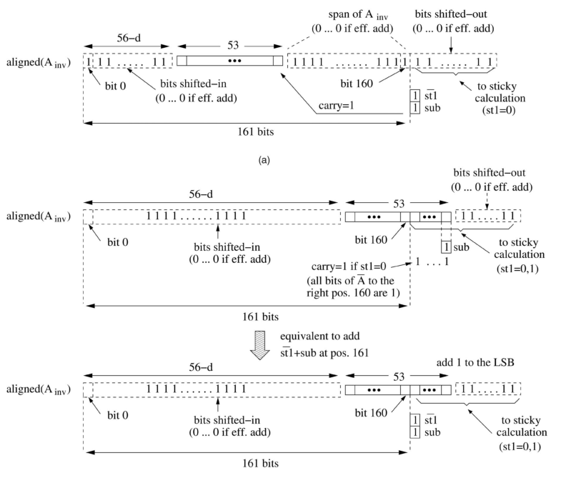
The +1 for 2’s Complement After the Alignment
When the operation is effective subtraction (a*b-c or -a*b+c), the accumulator should be inverted and +1
The +1 introduce extra logic delay before the product and accumulation summation logic
The figure shows how to move the +1 to after the alignment, thus it can be add into the product and accumulator summation logic
please note the figure is an example for Double Precision MAC, but the concept is the same

Slide 17
Exponent Data Path (1/)
F1 stage
To reduce F2 register and adder width, separate to 2 cases
Case-1: Align_amount <= 8
f1_exponent = expC + (align_amount && ~align_amount_zero) + 1
the +1: accumulator hidden-1 is at bit 31, but the added result may overflow to bit 32; so the LZC is count from bit 32
Since the Case-1 is a far path, why add align_amount in F1, then sub align_amount (LZC) in F2
to facilitate such algorithm, align_amount[5:0] and align_amount_gt8 signal should be pipe to F2, extra muxes on LZC, and extra overflow detection logic, which is missing in V2 architecture
compared with current approach, the cost is one 7-bit adder, and the timing is not a problem
Case-2: Align_amount > 8
f1_exponent = expA + expB - BIAS + 3
F2 stage
f2_exponent = f1_exponent - LZC
Final stage
final exponent = f2_exponent + (y_all1 & y_inc)

Slide 18
Exponent Data Path (2/)
F1 case 1 might be the critical path
f1_exponent = expC + (align_amount && ~align_amount_gt0) + 1
solution: calculate the exponent ahead of the align amount comparators
f1_exponent = (align_amount < 0) ? expC + 1
expC + align_amount + 1 => expA + expB - BIAS + 12
further reduce the expC + 1 incrementor by move the + 1 to F2
original
f2_lzc_to_subnorm = f2_mac_exp - 1;
f3_mac_exp_nx = (f2_subnorm_pred | f2_mac_exact_zero) ? 7'b0 : f2_mac_exp - f2_lzc;
modified
f2_lzc_to_subnorm = f2_mac_exp;
f3_mac_exp_nx = (f2_subnorm_pred | f2_mac_exact_zero) ? 7'b0 : f2_mac_exp - f2_lzc + 1;
will the (f2_mac_exp - f2_lzc + 1) becoming larger logic?
a - b + 1 => a + ~b + 2

Slide 19
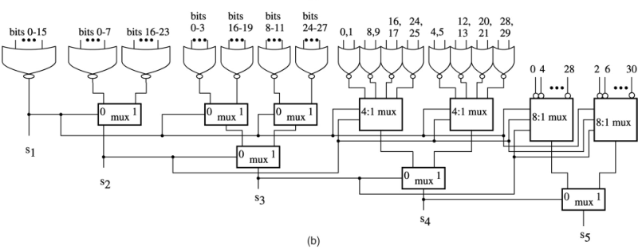
LZA: no longer LZA, just LZC
With uArch V2, there is no LZA, just LZC for the added result
no LZA error either
Use structuralized LZA
Or network has bigger area but shorter latency
LZA error
timing is ok, an additional 1-bit shifter is add after the normalization shifter

Slide 20
Why a HA is needed before the LZA
We want to keep the original exponent/fraction data path, which is much simple
When use simple (^b_{i})&(|b_{i-1}) LZA
LZA error and exponent increment caused by rounding can be occurs at the same time
That introduce an (exponent + 2) case for the final result
Increase the complexity of final result logic
With V2 uArch, this issue is no longer exist

Slide 21
The Lost +1 When the MAC Sum is Negative (1/)
To complete the 2’s complement form of the MAC sum, the MAC sum should be +1 after inversion
A technique is introduced to combined the +1 into the rounding increment log, instead of add before rounding, which will adds logics on the critical path
define complement: when the MAC sum is negative, the complement is 1
Observation:
the +1 is only effective when the round-off bits are all-ones => normalization should shift with the complement instead of zeros
when the round-off bits are all-one and complement = 1 => the REAL round-off bits (after the +1) will be all 0, thus no longer round increment => the result +1 cause by the complement and rounding increment is exclusive => the complement +1 event can be add into the original round increment logic

Slide 22
The Lost +1 When the MAC Sum is Negative (2/)
Rounding bits calculation
sticky_msb_inc = sticky_bits_except_msb_all_one & ~align_sticky & complement
{L’, R’, Sm’} = {L, R, Sm} + {2’b0, sticky_msb_inc}
L => LSB of fraction
R => rounding bit
Sm => MSB of sticky bits
Round increment
original rounding increment, or
complement +1 propagated to the LSB
Such technique might not be practical for FMAC DP, since the normalization starts before the complement signal ready

Slide 23
Exceptions – Invalid Operation
Any general-computational or signaling-computational operation on a signaling NaN
Multiplication: multiplication(0, ∞) or multiplication(∞, 0)
IEEE 754: fusedMultiplyAdd(0, ∞, c) or fusedMultiplyAdd(∞, 0, c) unless c is a quiet NaN; if c is a quiet NaN then it is implementation defined whether the invalid operation exception is signaled
RISC-V spec: must set flag even when the addend is a quiet NaN
Addition or subtraction or fusedMultiplyAdd: magnitude subtraction of infinities, such as: addition(+∞, −∞)

Slide 24
Exceptions – Overflow
If the destination format’s largest finite number is exceeded in magnitude by what would have been the rounded floating-point result
Detection
Compare before rounding for speed
Compare the unbounded exponent and unbounded exponent + 1 together, then select after the rounding result comes out
Bounded value when Overflow exceptions occurs
see special value: infinity, special value: largest value

Slide 25
Exceptions – Underflow (1/)
IEEE 754 definition:
Signaled when a tiny non-zero result is detected
Tininess may detected as
Before rounding - when a nonzero result computed as though both the exponent range and the precision were unbounded would lie strictly between ± 2^{Emin}
After rounding - when a nonzero result computed as though the exponent range were unbounded would lie strictly between ± 2^{Emin}
RISC-V definition:
Tininess is detected after rounding

Slide 26
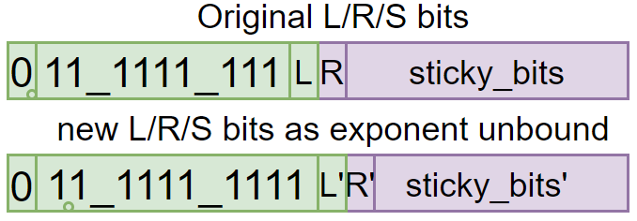
Exceptions – Underflow (2/)
Detection:
Condition 1: the unbounded result is between ±2^{Emin} and doesn’t rounded to a normal value
hidden one before rounding is 0, and
without round increment or fraction is not all 1
Condition 2: the unbounded result is between ±2^{Emin} , but rounded to a normal value; however, the result will still between ±2^{Emin} if rounded as the exponent is unbounded
hidden one before rounding is 0, and
with round increment, and fraction is all 1, and
~(L’ & ((ri & (R’|stick_bits’)) | (rne & R’ & (L’|sticky_bits’)) | (rmm & R’))
=> ~(L’ & (ri & (R’|sticky_bits’) | (rne & R’) | (rmm & R’))
ri: round to ± inf
rne: round to nearest even
rmm: round to nearest max magnitude

Slide 27
Exceptions – Inexact
Signaled when the rounded result of an operation is inexact
it differs from what would have been computed were both exponent range and precision unbounded
Detection
non zero round bit or sticky bit, or
overflow

Slide 28
Special Value – Zero (1/)
Zero (0x0000/0x8000)
0 +/- 0
detect in the 1st stage
Sign
(+0) + (+0) => +0
(+0) + (-0) => RDN: -0, others: +0
(-0) + (-0) => -0
Result is exactly zero
detected after the product is added to accumulator (in the f2 stage)
the result is -0 if round to -inf

Slide 29
Special Value – NaN (2/)
NaN (0x7e00)
Detect in 1st stage
Cases
One of the operand is a NaN
(+Inf) + (-Inf)
Inf * 0
Set invalid exception if one of the operand is a signaling NaN

Slide 30
Special Value – Infinity (3/)
Infinity (0x7c00/0xfc00)
Detect in 1st stage
One of the operand is an Inf, none is NaN
for the product, if one operand is an Inf, the other one shouldn’t be zero
if both of the product/accumulator is an Inf, their sign should be the same
Detected in last stage
overflow exception occurs and,
round mode is RNE/RMM/RUP w. positive result/RDN w. negative result

Slide 31
Special Value – Smallest Value (4/)
Non-zero smallest value (0x0001/0x8001)
Detected in last stage
result is not zero, smaller than the smallest subnormal and,
unbounded result exponent < Emin
rounding mode is RUP w. positive result/RDN w. negative result
Could be reduce to normal arithmetic path?? => yes, verified

Slide 32
Special Value – Largest Value(5/)
Non-infinity largest value (0x7bff/0xfbff)
Detect in last stage
overflow exception occurs and,
rounding mode is RDN w. positive result/RUP w. negative result

Slide 33
Pending Work
eff. sub might on the critical path: optimize instruction encoding
Investigate 32 MAC Adder PPA
3-stage: better timing, but worse area (+200 gates)

Slide 34
PPA
Genus, 28HPC+ (tcbn28hpcplusbwp30p140ssg0p81vm40c)
3-stage
1GHz: 3.21 kgates
1.2GHz: 4.67 kgates
2-stage
with dual normalizer, complement inverter moved to F1
1GHz: 3.98 kgates
1.2GHz: -26ps slack

